Slide 1
NHẬP MÔN LẬP TRÌNH WEB

Slide 2
  Cài đặt Git
  Cài đặt Visual Studio Code
  Cài đặt Chrome Browser
PHẦN MỀM CẦN CÀI ĐẶT

Slide 3



HELLO, I’M NAM.
Scrum Master/Team Leader at Axon Active (AxonActive.com).
Bachelor Of Finance Management.
Bachelor Of Software Technology.
Text to me : 0932 578 992 or connect to me via social network below.
/namnh06
namnh.developer@gmail.com
hainamdng
/hainam37k16.1

Slide 4
SOME RULES
Slide and Exercise 100% English, speaking by Vietnamese.
No Facebook, no YouTube, no Twitch, no Mobile, no connect to people outside if it’s not an emergency …
Google first is the best, notebook, pen, thinking, do by your self, search by your self, drawing on your paper.
Feel free to ask me, but make sure you searched at least 5 minutes.
/namnh06
namnh.developer@gmail.com
hainamdng
/hainam37k16.1

Slide 5
YOUR TURN
Come over here, one by one and speak loudly to the class :
What’s your name ?
What’re you doing?
Describe your programming experience.
What’re you looking for from this class?

Slide 6
WEB DEVELOPER 2019 ROADMAP
https://github.com/kamranahmedse/developer-roadmap

Slide 7
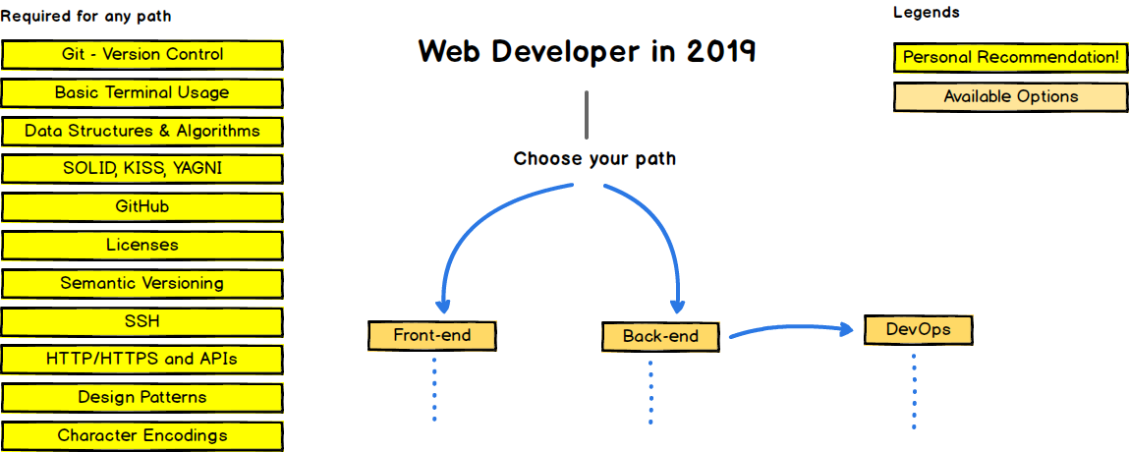
FROM WHAT YOU ARE LOOKING FOR

Slide 8
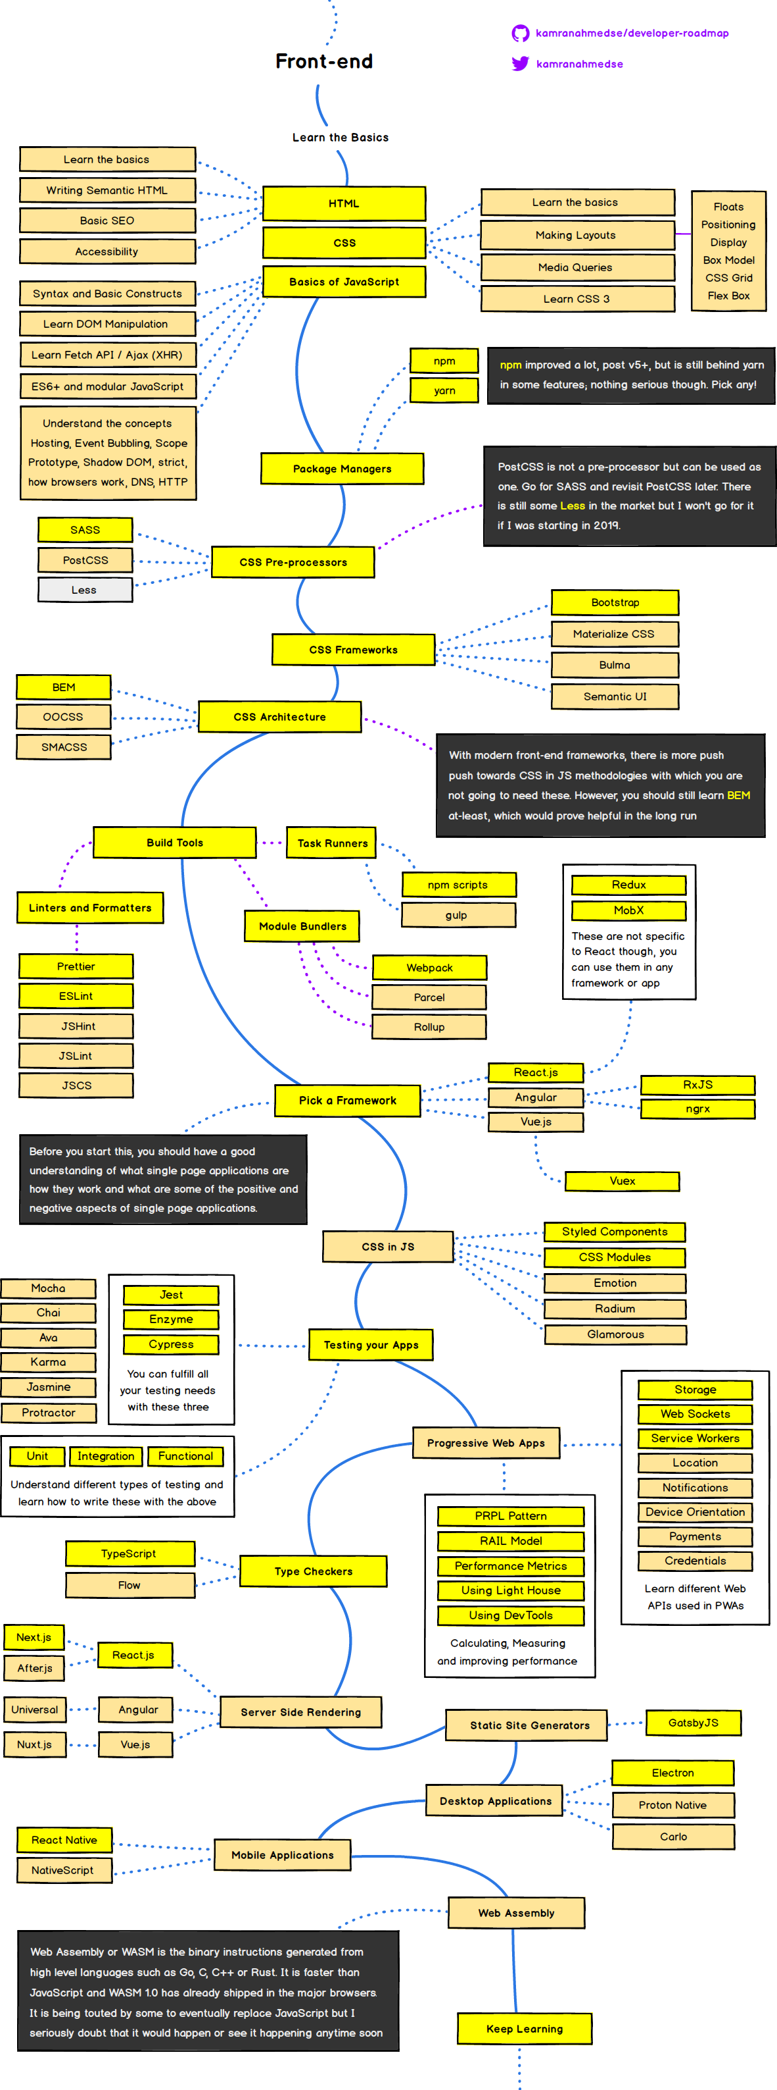
FROM WHAT YOU ARE LOOKING FOR

Slide 9
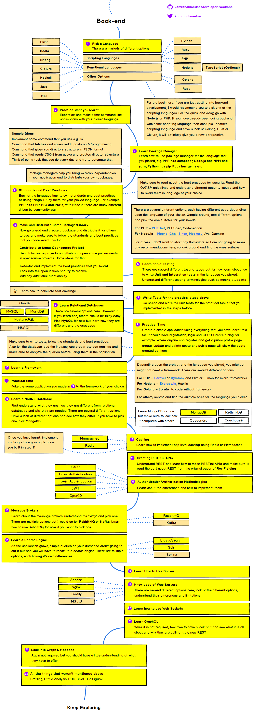
FROM WHAT YOU ARE LOOKING FOR

Slide 10
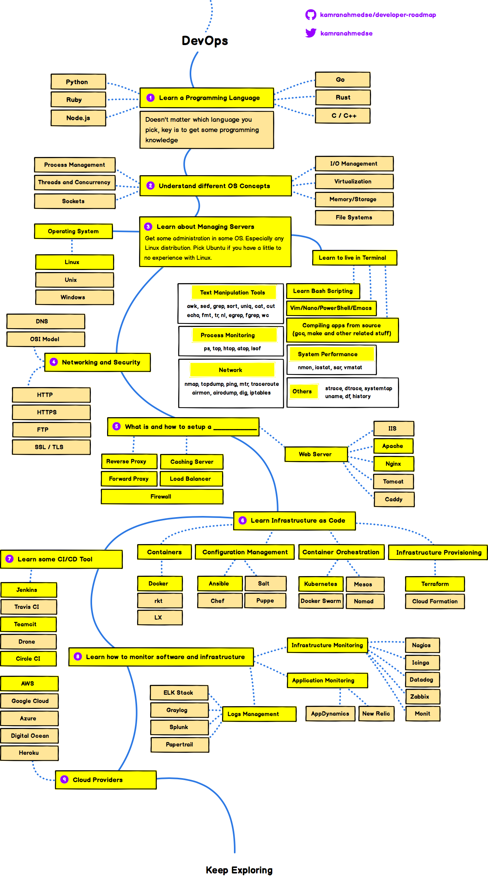
FROM WHAT YOU ARE LOOKING FOR

Slide 11
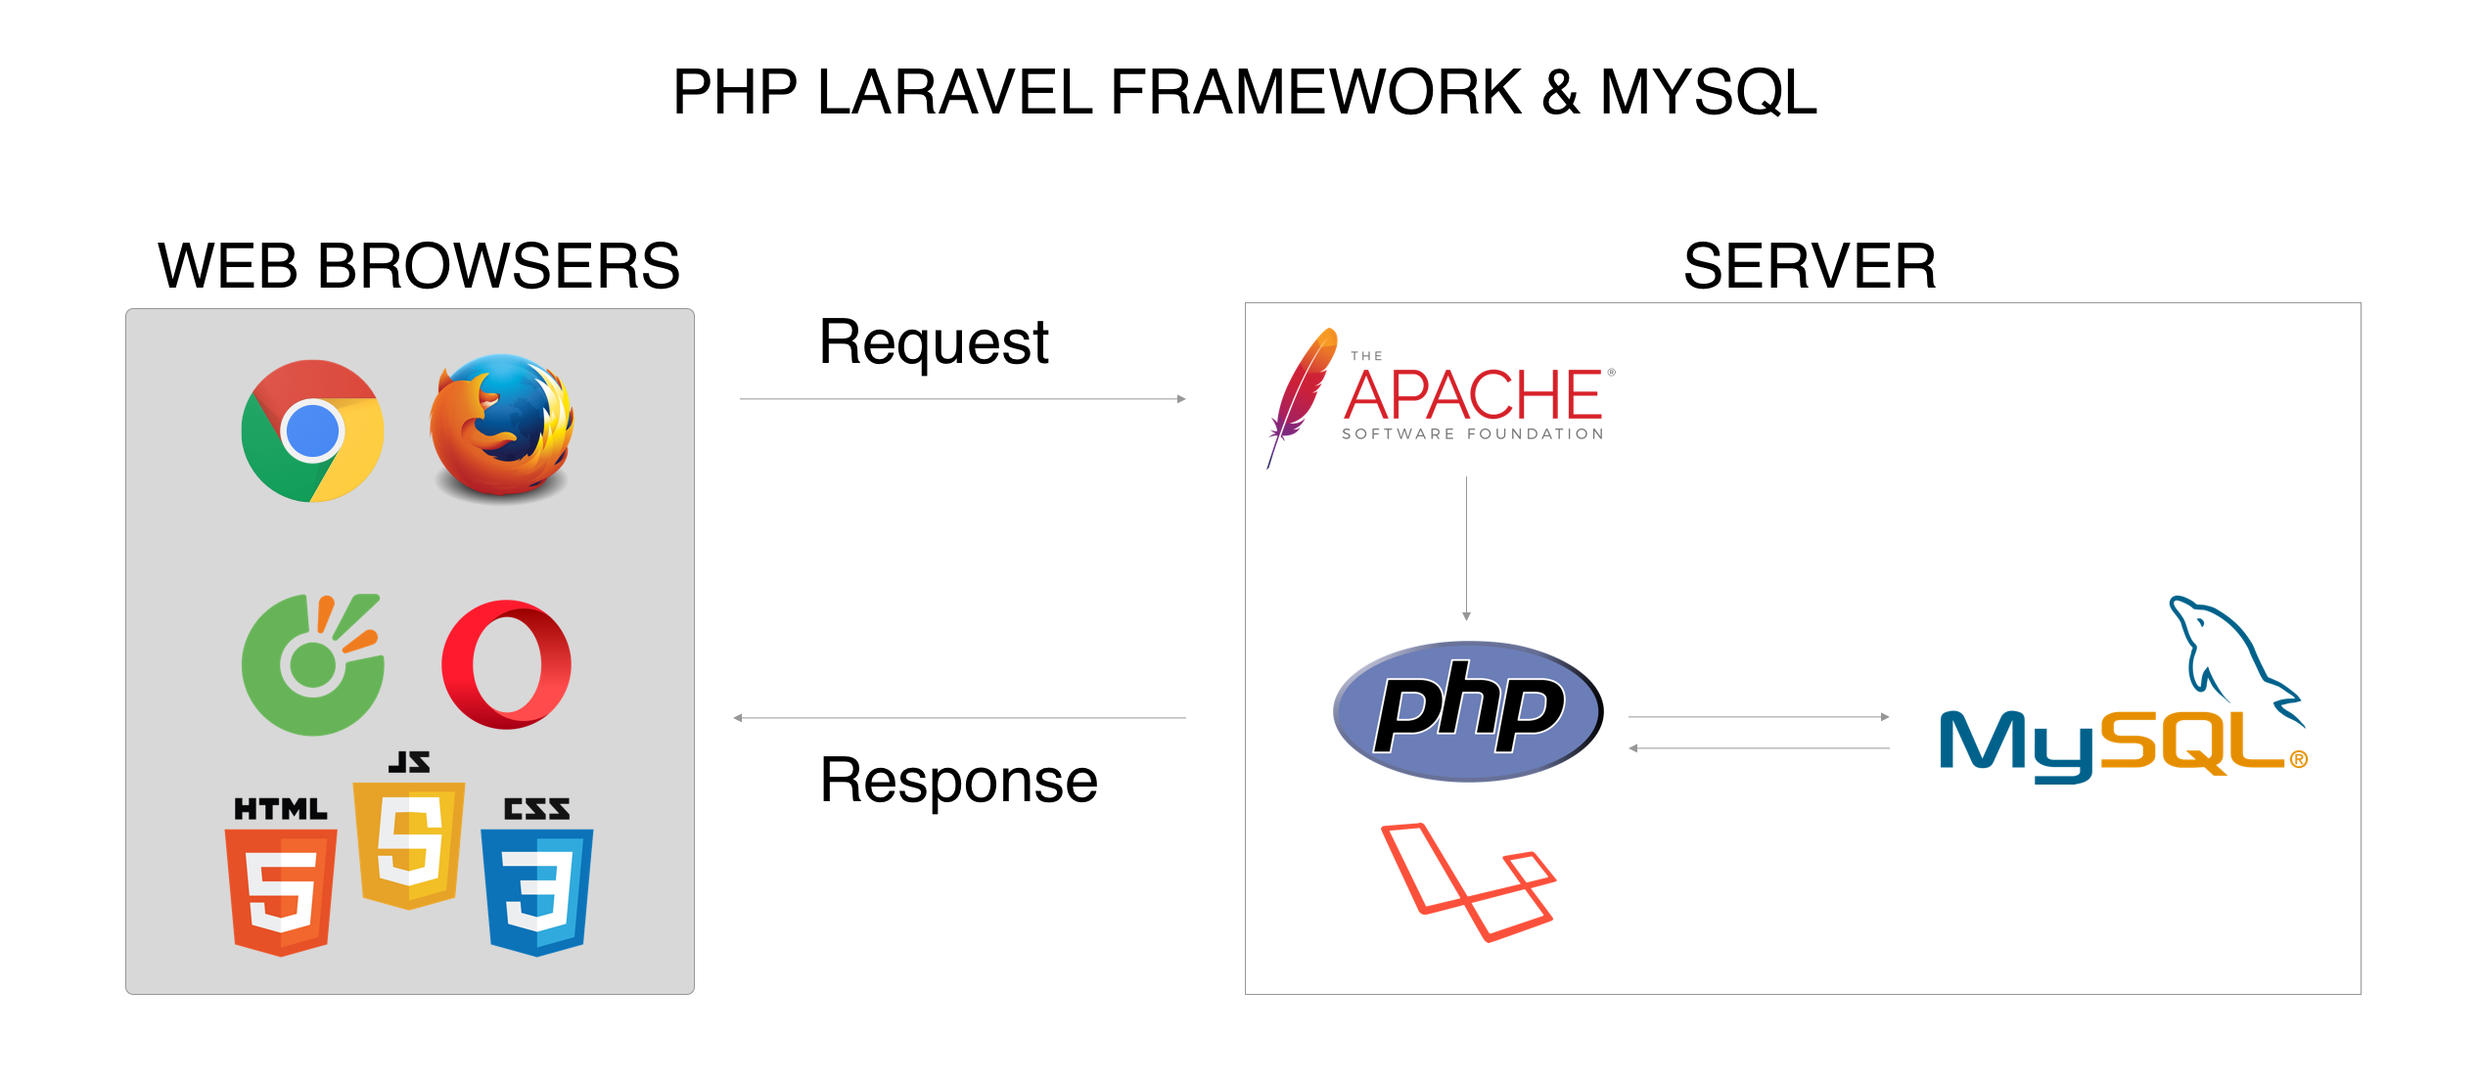

Slide 12
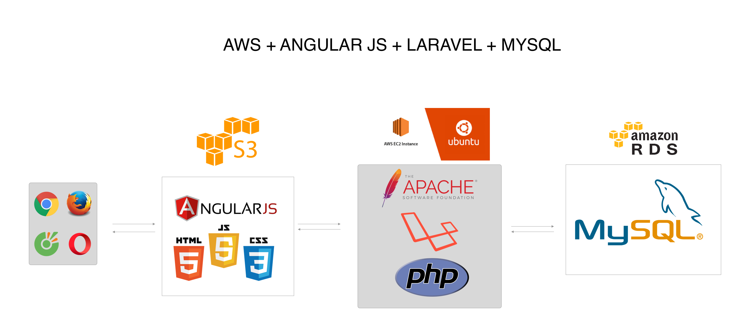

Slide 13
OUR SCHEDULE
We only have 60 hours – 15 sessions :
Introduction & Environment : 4 hours – 1 sessions.
HTML & CSS & Bootstrap 4 : 32 hours – 8 sessions.
JavaScript & jQuery & AJAX & JSON : 16 hours – 4 sessions.
Project News Website Template : 8 hours – 2 sessions.
* Git Hub, Git Page, VS Code, Command Line will be guided in some session.

Slide 14
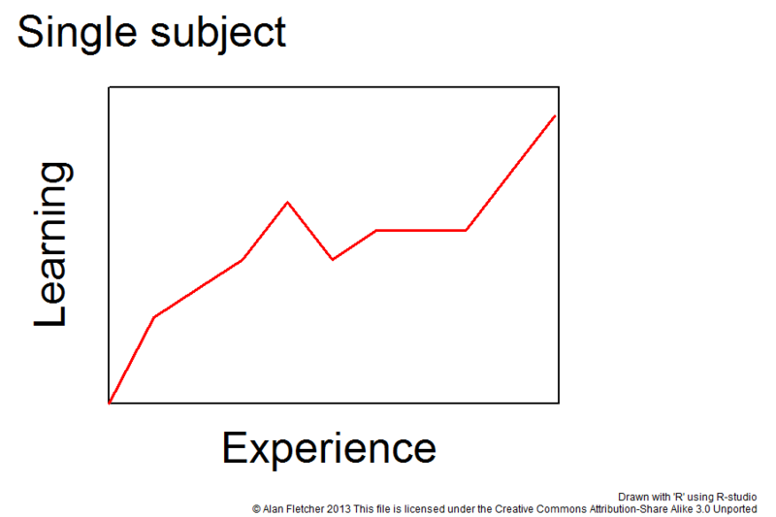
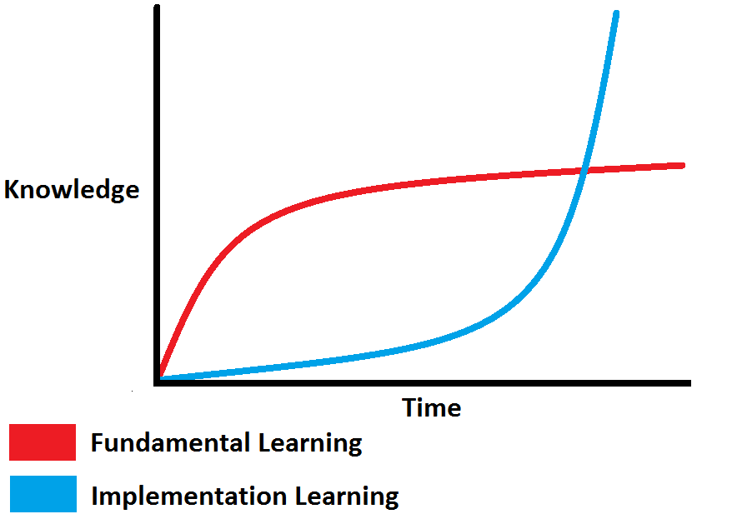
HOW TO GET ALL OF IT ?
Do one by one.
From zero to hero.
Cost by time.
Learn from friends.
Learn from games.
Learn everytime and every sources you have.

Slide 15
MY RESOURCES
Freecodecamp.org
W3schools.com
Udemy.com
Lynda.com
Medium.com
Viblo.asia
Kipalog.com
Tutorialspoint.com
Freetuts.net
Vietjack.com

Slide 16
LET’S DO IT TOGETHER !!!

